Slide 1
About staying young
According to science

Slide 2



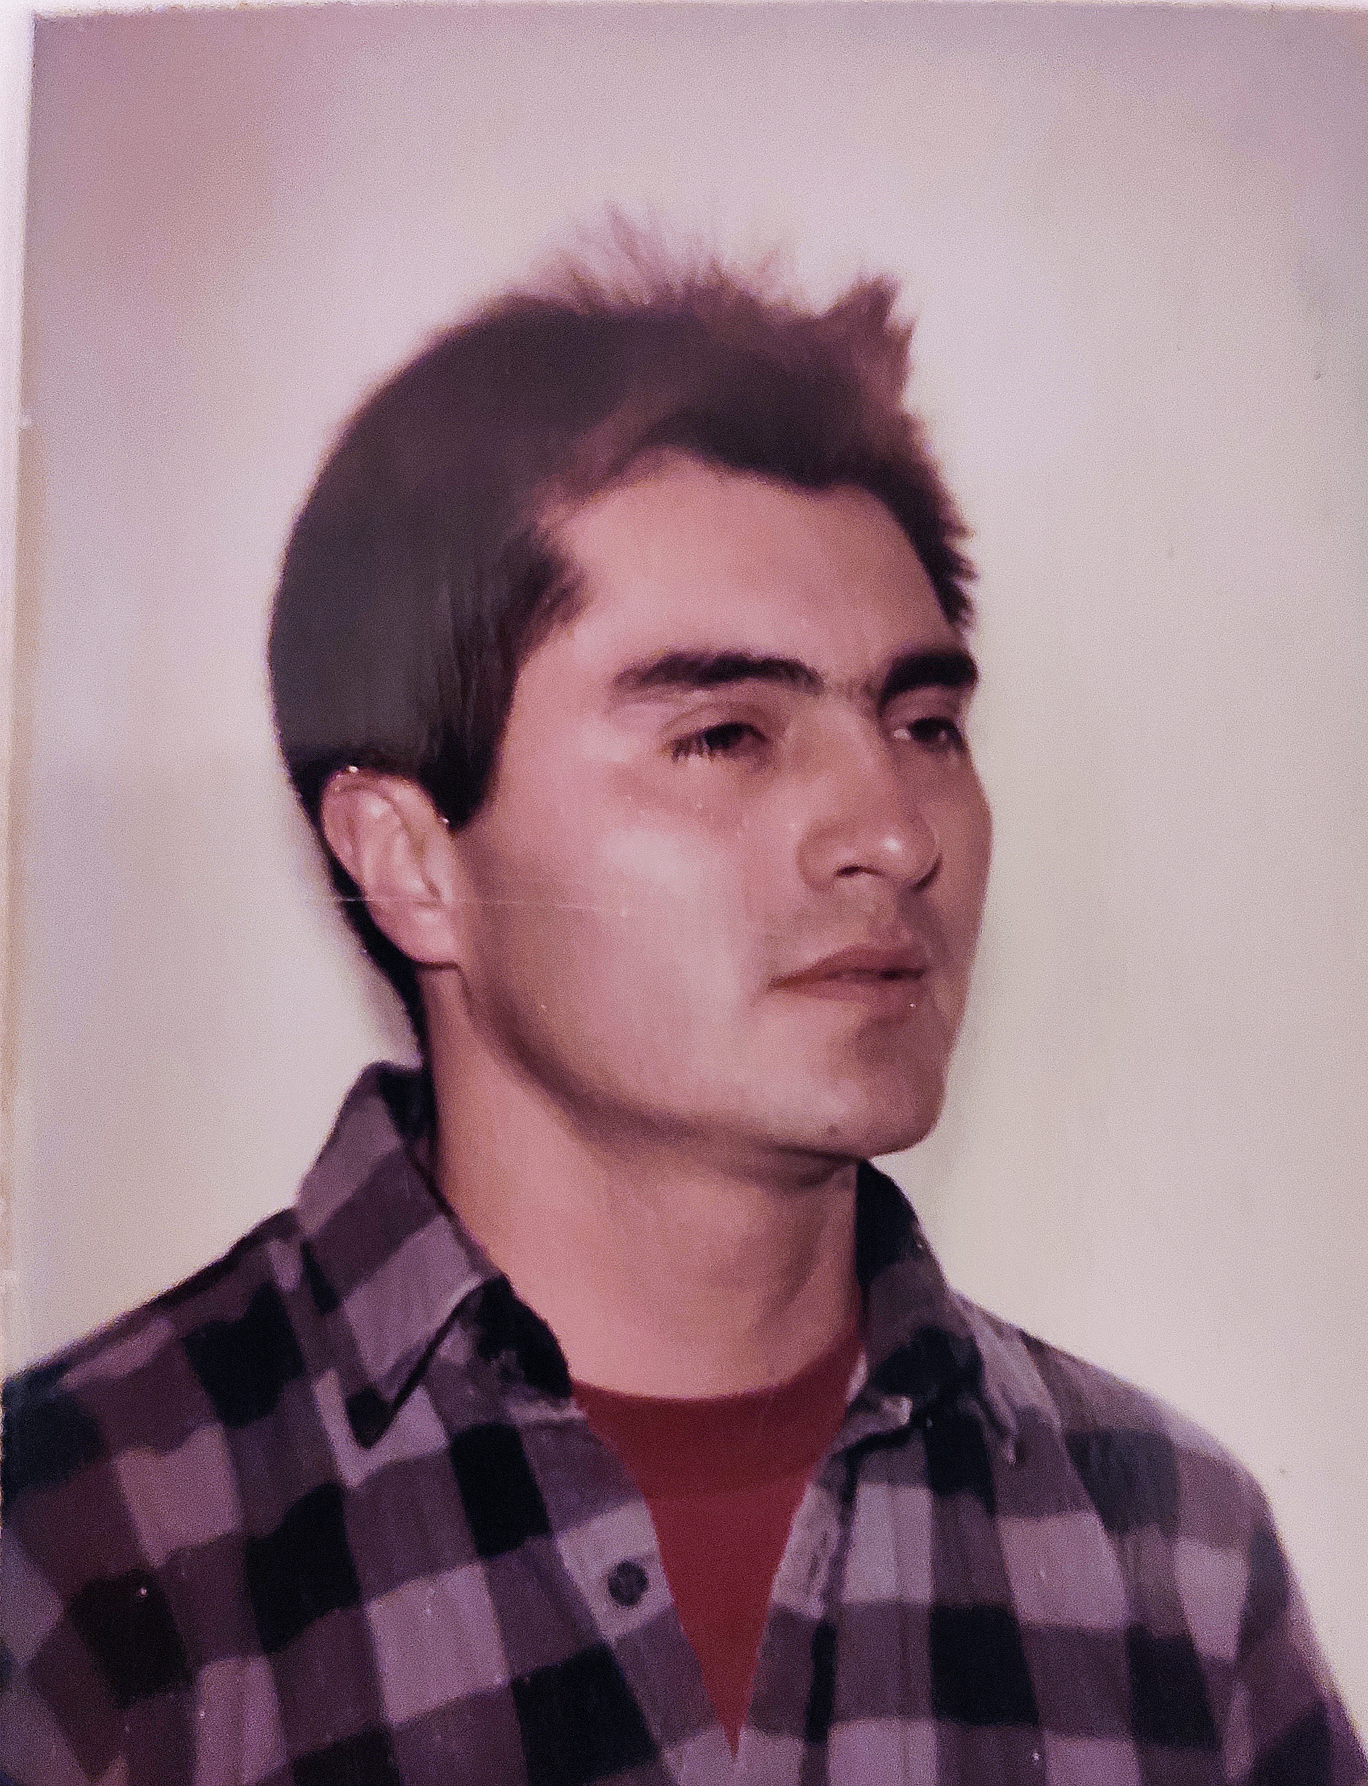

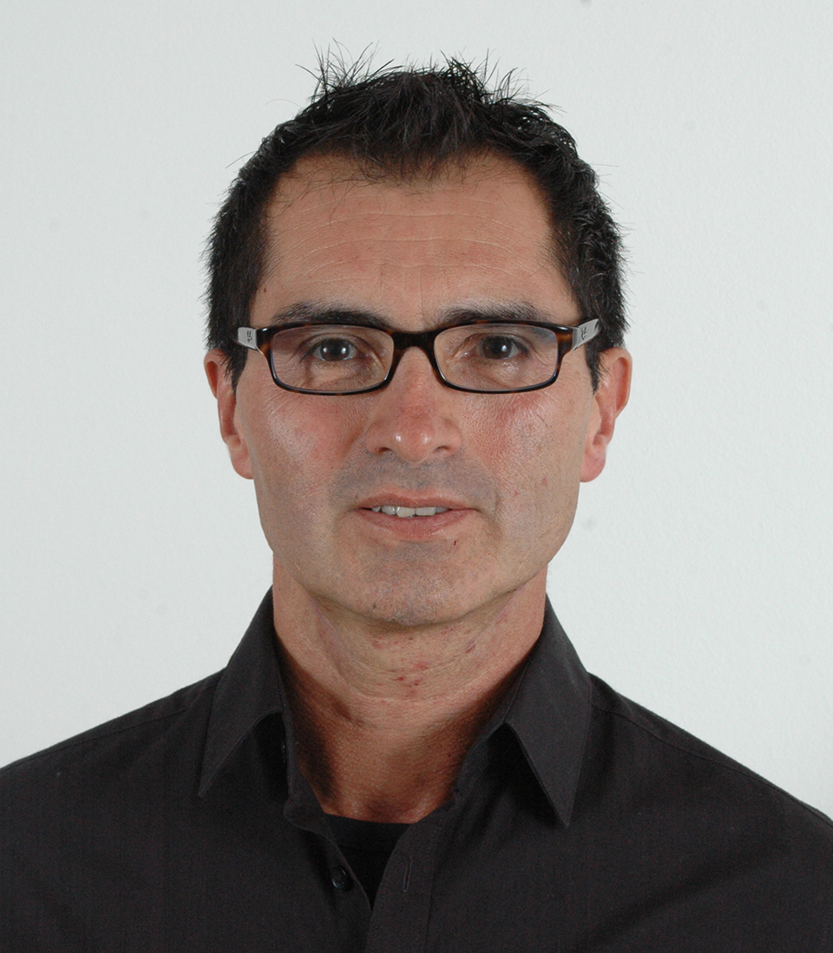



About me
Jesus Gonzalez VAZQUEZ
Jesus BASAIL

Slide 3
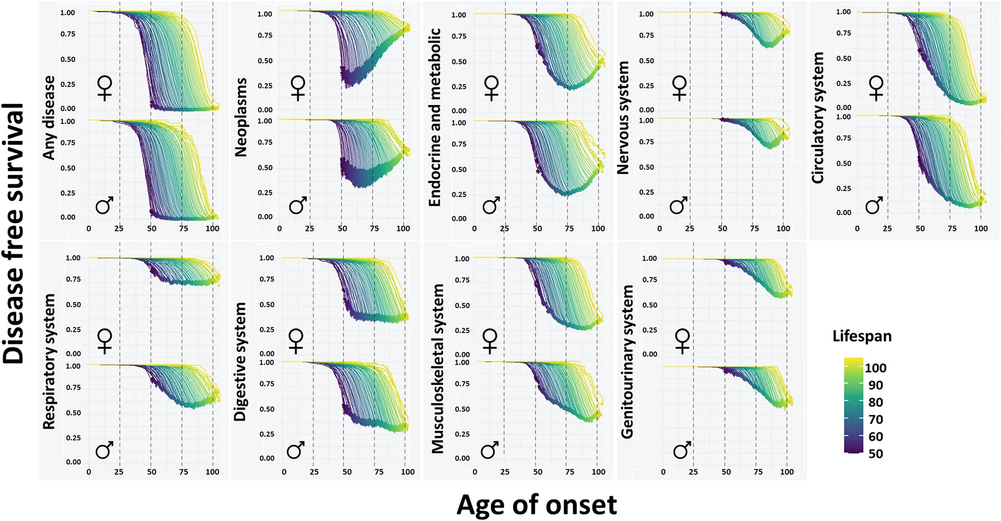
Health span Morbidity compression
Source: Human lifespan and sex-specific patterns of resilience to disease: a retrospective population-wide cohort study, Joaquim Sol, Marta Ortega-Bravo

Slide 4
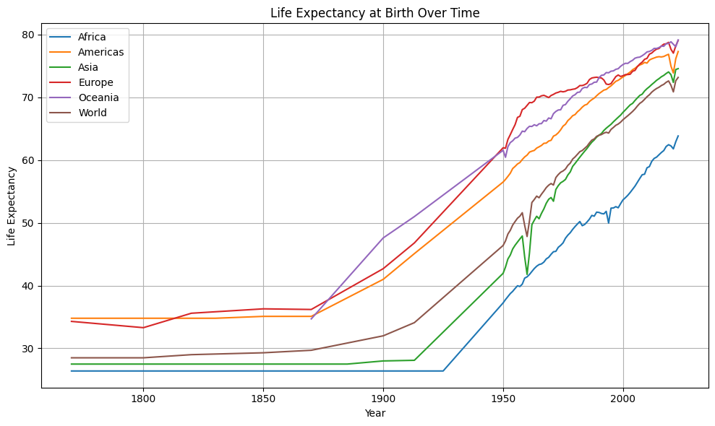
Longevity increase timeline
Data source: UN WPP (2024); HMD (2024); Zijdeman et al. (2015); Riley (2005) OurWorldinData.org/life-expectancy

Slide 5

Science backed
Source: 2024 Longevity Summit.
Eric Verdin, MD
President and CEO
Buck Institute for Research on Aging

Slide 6
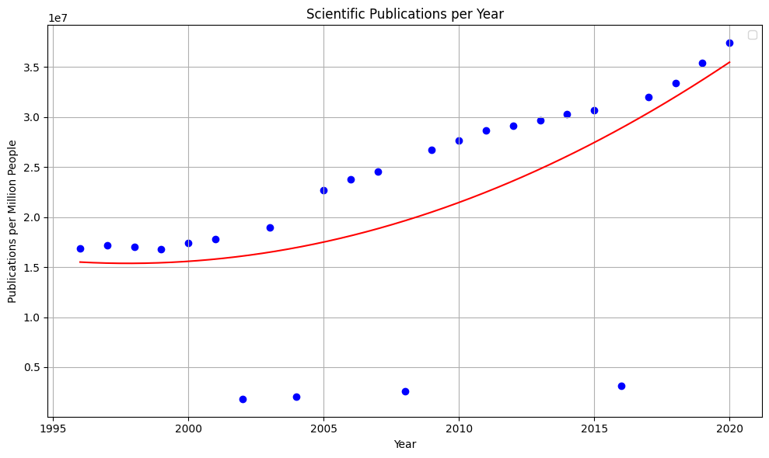
Information overload

Slide 7
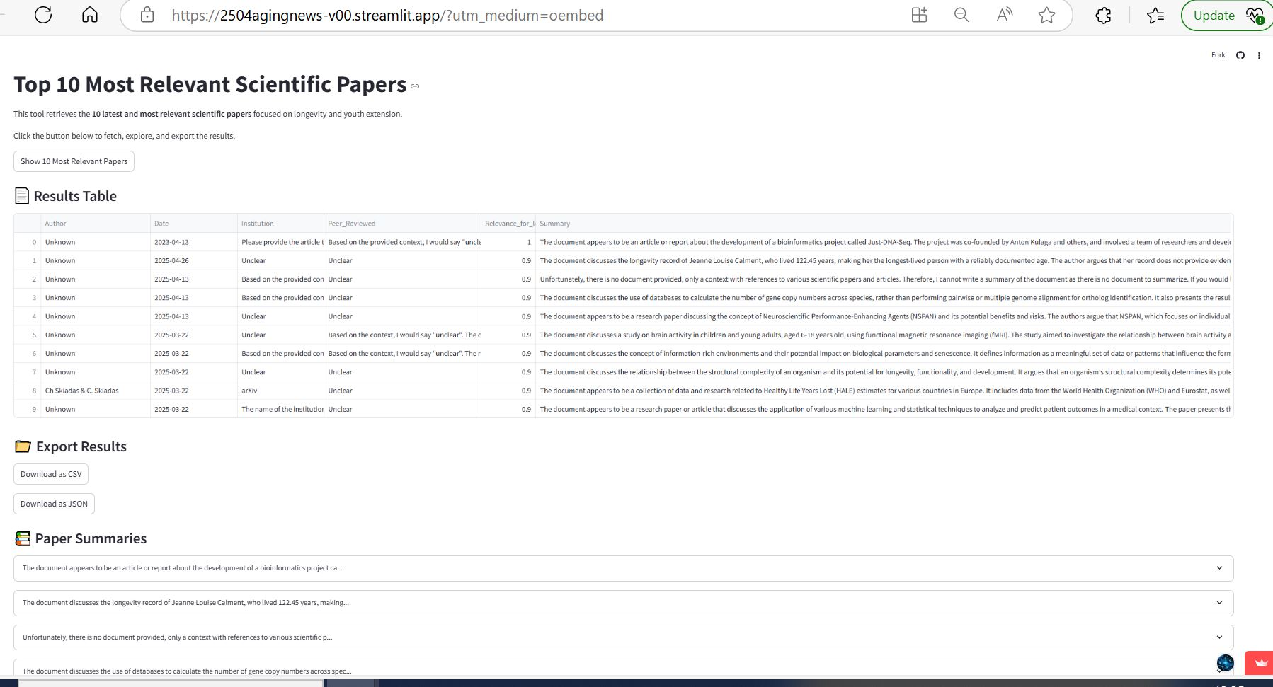
Our solution: App filtering

Slide 8
Features & Functionality
Uses NLP, AI technology and DS principles
Takes real data from the web
Assigns relevance
Creates a summary of each document
On the press of a button
Displays a list with the most important info
Results can be downloaded

Slide 9
Our solution AI agentic system

Slide 10
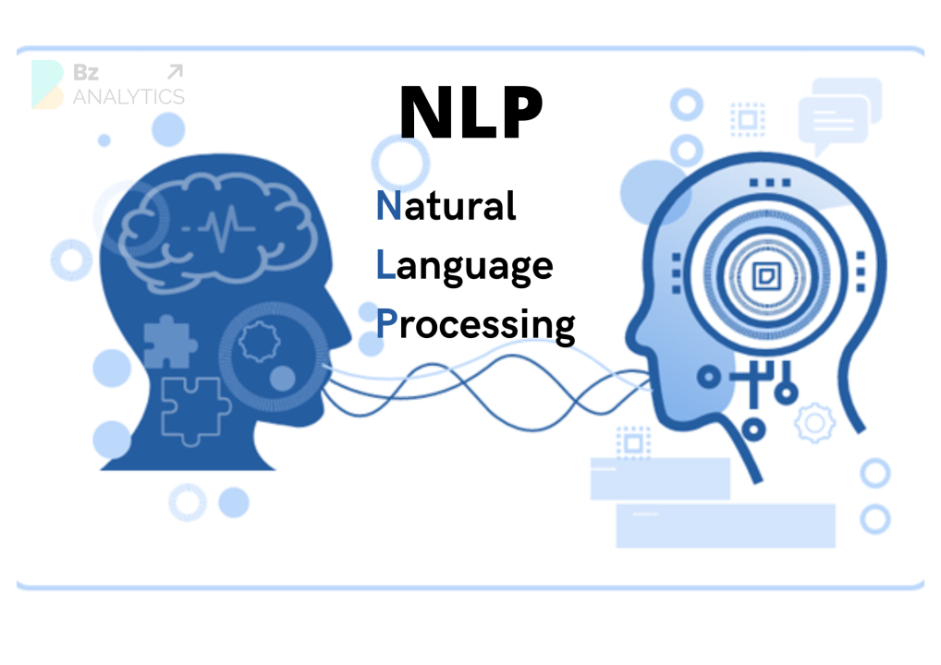






Tech Stack & Tools:
Python 3.12
Llama3-8b-8192
sentence-transformers/all-mpnet-base-v2
AWS S3 Storage
IONOS www.jesusbasail.com
Sreamlit, GitHub
Wordpress
Storage for Scraping: AWS- S
Public Databases: PubMed, Nature, ArXiv
API’s

Slide 11
Metrics:
Llama 3.1 8B:
High Accuracy on MMLU 69,4 %
Pass rate on Human Eval 72,6 %
MATH 51,9 %
There is no industry consensus
Not easy to implement
Importance is undeniable
Need to develop Evaluation DS
NER, Relevance, Summarization diff. Metrics
Use LLM to create eval DS
Currently common practice is human evaluation

Slide 12
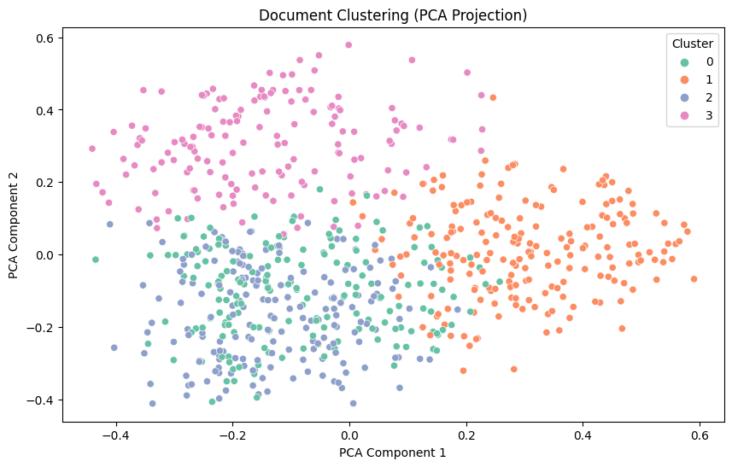
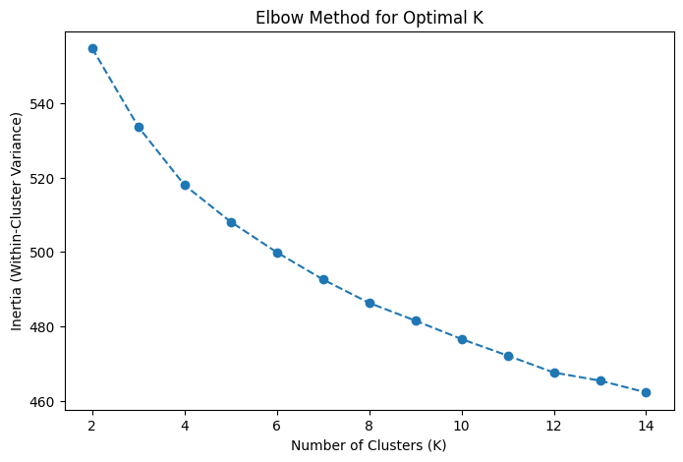
Learning Curve and base model: BERT

Slide 13
Conclusion & Future Work

Slide 14
Future:

Slide 15
Thank you, questions?
Jesus gonzalez vazquez
+49 160 807 6571
email@jesusbasail.COM
WWW.jesusbasail.COM

